Slide 1


LABORATORY FLOOR PLAN
GROUP 04
24 Aug 2021
Suraweera R M S P K –HS21908910
Kumara M W G A U– HS21911958
Rukshan M A R – HS21909764
Yohan M P C –HS21934032
Dilhara K A C – HS21935022
Liyanage L H K – HS21911262
Kumarasinghe Y G A K– HS21909832
Senevirathne D M D U– HS21907098
Lokuwithana L T D – HS21910036
Dahaneka M U R D– HS21922916

Slide 2
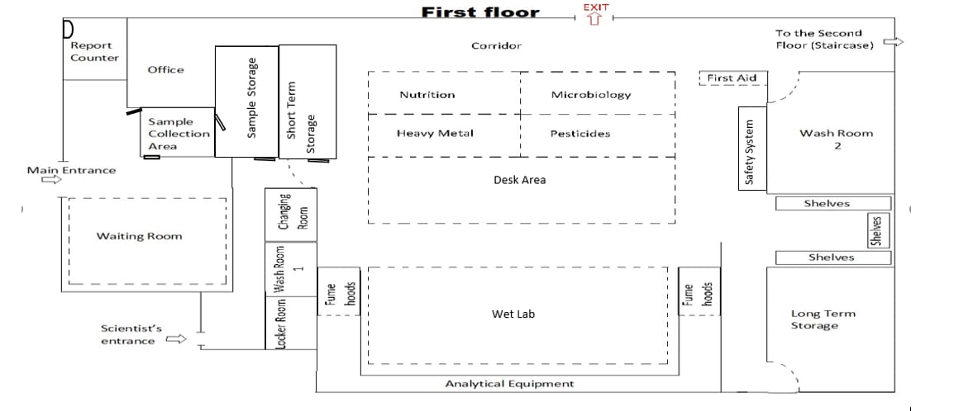

Slide 3
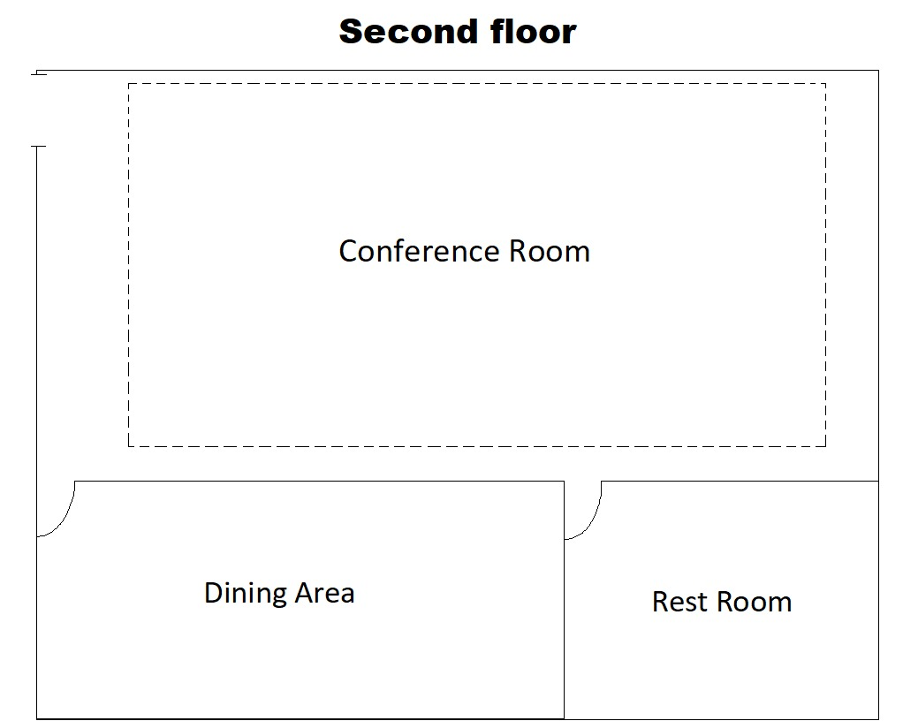

Slide 4
THANK YOU !

